Slide 1
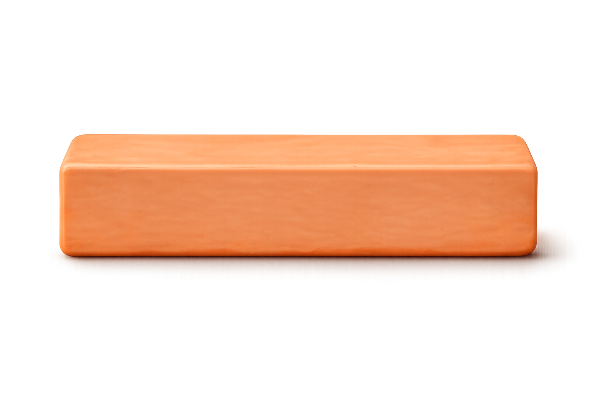
Let’s explore how the same value can be shown using different fractions.
Pulsate the blocks one by one and also pulsate one whole block right side
Divide the block into equal parts
=
6
1
=
2
3
4
2
After 2 seconds highlight the slider and add slicer
One Whole
clay block

Slide 2
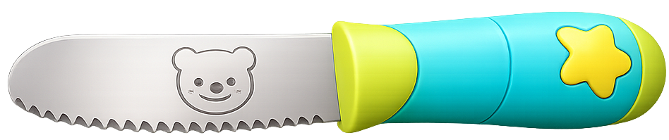
Watch how a whole can be divided into equal parts.
Pulsate first block and after 2 seconds dehighlight 2nd and 3rd block and should appear like next slide
Divide the block into equal parts
=
6
1
=
2
3
4
2
One Whole
clay block

Slide 3
Divide the whole into 2 equal parts.
Divide the block into equal parts
=
6
=
2
3
4
If the user move the knife other than 2, block can be divided into that many parts and then teeter the block, move back the knife to original position, when place the knife in the correct number, just lock the knife at that number showing green highlight around the block.
2
One Whole
clay block

Slide 4
Divide the whole into 2 equal parts.
First pulsate 2 in the slider and then Make an animation of cutting block into two equal parts using knife (knife should come from the slider), resulting slide should look like below.
Divide the block into equal parts
=
6
=
2
3
4
2
One Whole
clay block

Slide 5
Select 1 out of 2 equal parts.
After one second of cutting, hand icon like below should appear.
Divide the block into equal parts
1
2
=
6
=
2
3
4
2
One Whole
clay block

Slide 6
Select 1 out of 2 equal parts.
Divide the block into equal parts
1
2
=
6
=
2
3
4
2
One Whole
clay block

Slide 7
Select 1 out of 2 equal parts.
When the user select one parts Pulsate one part and it should look in such a way that selected part come front. After 2 seconds fractions should appear like next slide pulsating one part out of two)
Divide the block into equal parts
1
2
=
6
=
2
3
4
2
One Whole
clay block

Slide 8
This is ½ of the whole.
After 2 seconds, dehighlight the first block and change the upper statement to “ Let's divide the second block into four equal parts, just like the next slide.
Divide the block into equal parts
1
2
=
6
=
2
3
4
1
2
2
One Whole
clay block

Slide 9
Now divide another whole into 4 equal parts.
Divide the block into equal parts
1
2
=
6
=
3
4
1
If the user move the knife other than 3, block can be divided into that many parts and then teeter the block, move back the knife to original position, when place the knife in the correct number, just lock the knife at that number showing green highlight arround the block.
2
2
One Whole
clay block

Slide 10
Now divide another whole into 4 equal parts.
Divide the block into equal parts
1
2
=
6
=
3
4
1
Follow the same flow and rule as dividing whole into two equal parts until the fraction appears.
2
2
One Whole
clay block

Slide 11
Follow the same rule as followed for the first block, the below slide should appear after showing the fraction of 2 out of 4.

Slide 12
Both show the same value using different numbers of parts.
Pulsate both the highlighted parts and then equal sign.
Divide the block into equal parts
1
2
1
2
3
4
=
6
=
3
4
1
2
2
2
4
One Whole
clay block

Slide 13
Same value, different fractions — these are called equivalent fractions.
Pulsate both the highlighted parts and then equal sign.
Divide the block into equal parts
1
2
1
2
3
4
=
6
=
3
4
1
2
=
2
2
4
After 2 seconds, dehighlight the first and second block and change the upper statement to “ Let's divide the third block into six equal parts, just like the next slide.
One Whole
clay block

Slide 14
Now divide another whole into 6 equal parts.
Divide the block into equal parts
1
2
1
2
3
4
=
6
=
4
1
2
=
2
2
4
One Whole
clay block

Slide 15
Follow the same rule as followed for the first and second block.

Slide 16
Equivalent fractions are different fractions that have the same value.
x2
x3
1
2
1
2
3
4
1
2
3
4
5
6
=
=
1
2
3
=
=
2
4
6

